Slide 1
TDD with angular-new
Josh Harrison

Slide 2
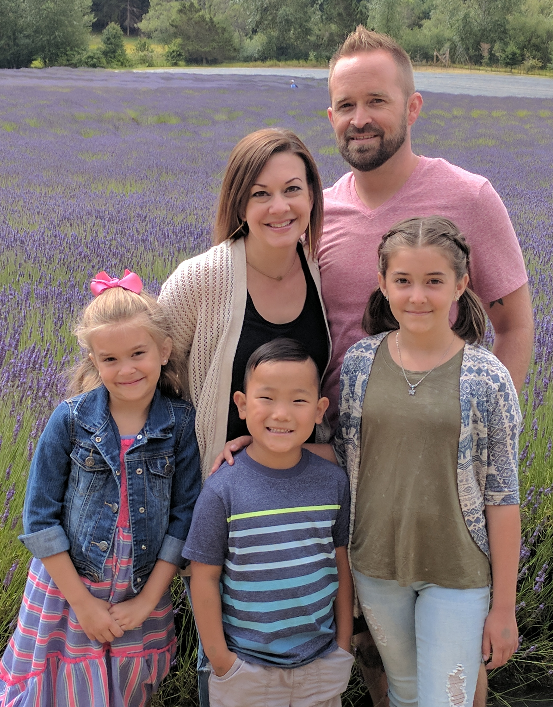
Josh harrison
Web Developer for the Tools and Technologies team as a part of IT ADOPT, and actively involved with Web Accessibility, Reusable UI Asset development, and coaching/mentoring Agile teams.

Slide 3
agenda
Angular CLI
Demo App Setup
Code

Slide 4
Angular cli
Angular-provided CLI
Generate components, services, etc.
Automatically generates HTML, SCSS, and spec files
ng generate <type> <name>
Serve application, run tests, etc.
ng serve
ng test [-sm=false]
Installed globally from NPM
https://cli.angular.io/

Slide 5


Angular cli - Tests
ng test
ng test -sm=false

Slide 6
Initial thoughts
Start with the end in mind
Keep tests independent and isolated
Group test suites into nested blocks
Single assert for each test

Slide 7
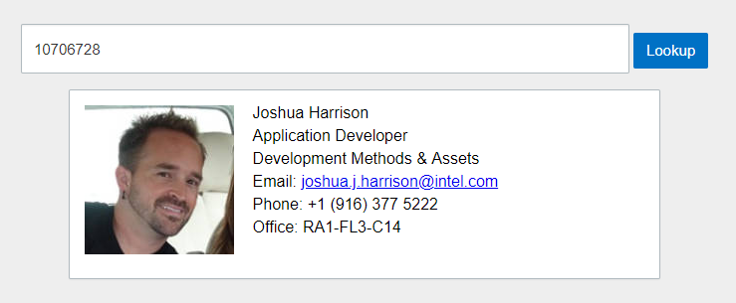
Demo app setup

Slide 8
Demo app setup
1
2
X
component
Worker API
service
spec
spec
html

Slide 9
Time to code

Slide 10
Example projects
https://github.intel.com/jjharris/ng-tdd-demo
https://github.intel.com/jjharris/ci-lego-workshop-ui

